Slide 1

HEALTHCARE PROJECT (Group- 6)
- KARAN RATURI​ - KARTHIK PEDDAVARAPU​ - NEELIMA NANDIGAM​ - SAI SHRUTHI PURUSHOTHAMAN​ - PRATHAMESH BOTE​ - DURGA PRASAD PAVAN NAMUDURI​ - NARRA VARUN REDDY​ - PRASANTH CHOWDARY YANAMANDALA​ - SAI MOKSHA GONGIREDDY

Slide 2
PROGRESS
MILESTONE-1 : PROJECT CHARTER DOCUMENT
(DOCUMENT DEFINING GOAL OF THE PROJECT, PROJECT WORKFLOW, ROLES & RESPONSIBILITIES OF TEAM MEMBERS)
MILESTONE-2 : PRESENTATION & DEMO
(PRESENTATION, DATA COLLECTION, MODULAR ARCHITECTURE, DATA CLEANING, ANALYSIS, DEMO)
MILESTONE-3 : FINAL PROJECT PRESENTATION
(PRESENTATION, FINALIZED VERSION OF DATASET, POWERBI DASHBOARD WITH INSIGHTFUL VISUALIZATIONS, A SIMPLE CHATBOT)
Notes:
Why It’s Important for Your Project
• It helps non-technical stakeholders understand your system
• Lets you build and improve each part independently
• Useful for presentations, documentation, and collaboration
3. Cleaned datasets are integrated using tools like Azure Data Factory.
4. Transformed and structured data resides in the Azure Data Lake.
• This layer serves as a reliable source for analytics and reporting.
6. Data from the lake is analyzed using Azure Synapse Analytics.
• This stage supports:
• SQL-based exploration
• Aggregation of prices
• Identifying trends and anomalies
7. Final insights are visualized using BI tools like:
• Power BI (highlighted as primary)

Slide 3
INTRODUCTION
Problem Statement:
Individuals often face challenges in selecting the most cost-effective health insurance plan due to limited transparency in procedure costs and insurance coverage across hospitals. The absence of clear, location-specific data makes it difficult for patients to make informed decisions tailored to their medical and financial needs.
Solution:
This project provides a data-driven solution that helps individuals in Pennsylvania, Maryland, West Virginia, and Washington D.C. identify the most affordable insurance plan and hospital combination for specific medical procedures. By aggregating and analyzing price transparency data from hospitals and insurance providers within these states, the platform offers clear comparisons of costs based on location and treatment type. The goal is to empower common people with accurate, localized insights so they can make well-informed, cost-effective healthcare decisions.

Slide 4
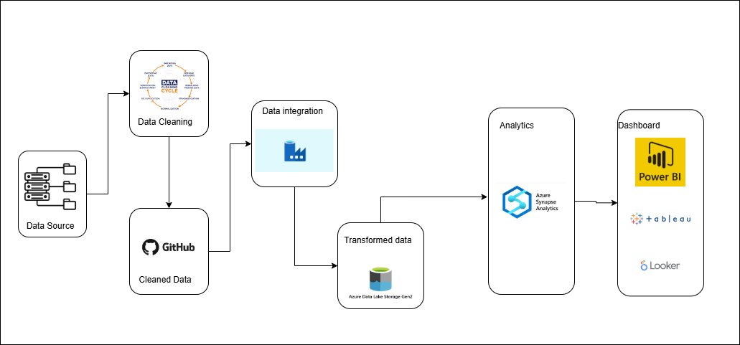
DATA ARCHITECTURE

Slide 5
CHALLENGES WE FACED
Missing Values
Inconsistent Data
Variations in CPT codes for a particular procedure
In MARYLAND, a statewide regulation mandates that all payers are charged the same rate for a given medical procedure, regardless of the provider or insurance plan.
No CPT codes, empty fields/ columns
The data for the state of Virginia is excluded from our analysis due to the absence of CPT codes, which are essential for procedure-level comparisons

Slide 6
SOLUTIONS
1. Interactive Power BI Dashboard
To enhance data transparency, we built a user-friendly Power BI dashboard that visualizes procedure-level pricing data across hospitals, providers, and states. Users can filter by procedure (CPT code), state, and provider to compare minimum, average, and maximum charges. Helps identify cost-effective options and spot pricing inconsistencies or outliers.
2. AI-Powered Healthcare Chatbot
We developed a prototype chatbot that allows users to input a CPT code or description and receive personalized insights. Returns the lowest available charge for a procedure across providers and states. Guides users to more affordable insurance-provider combinations.
Acts as a self-help tool to reduce reliance on manual support or confusing insurance documentation.

Slide 7
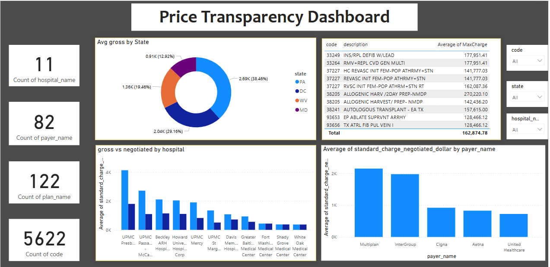
VISUALIZATIONS

Slide 8
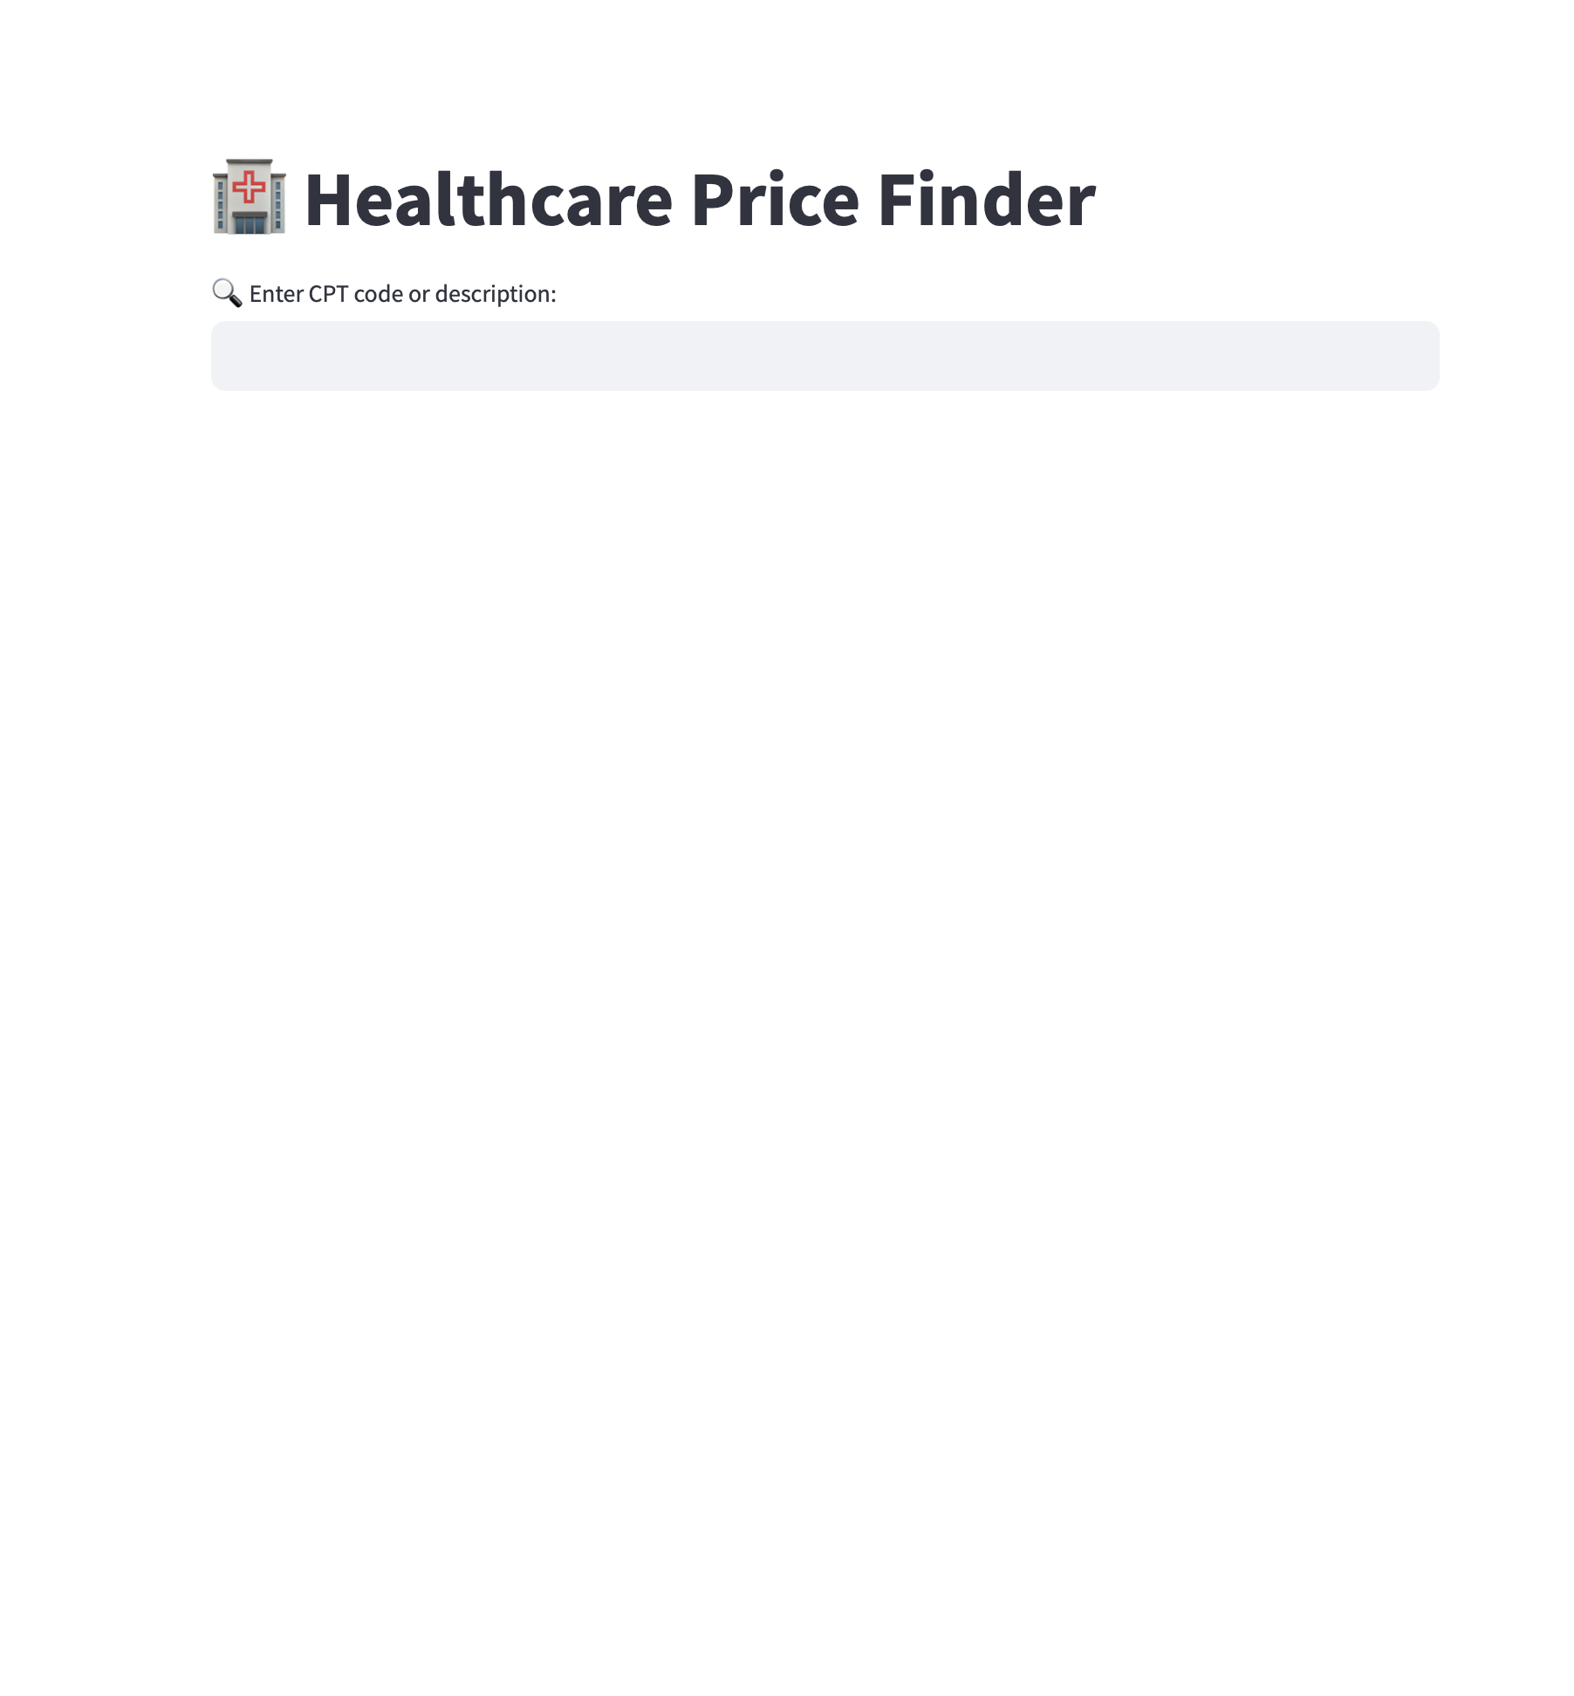
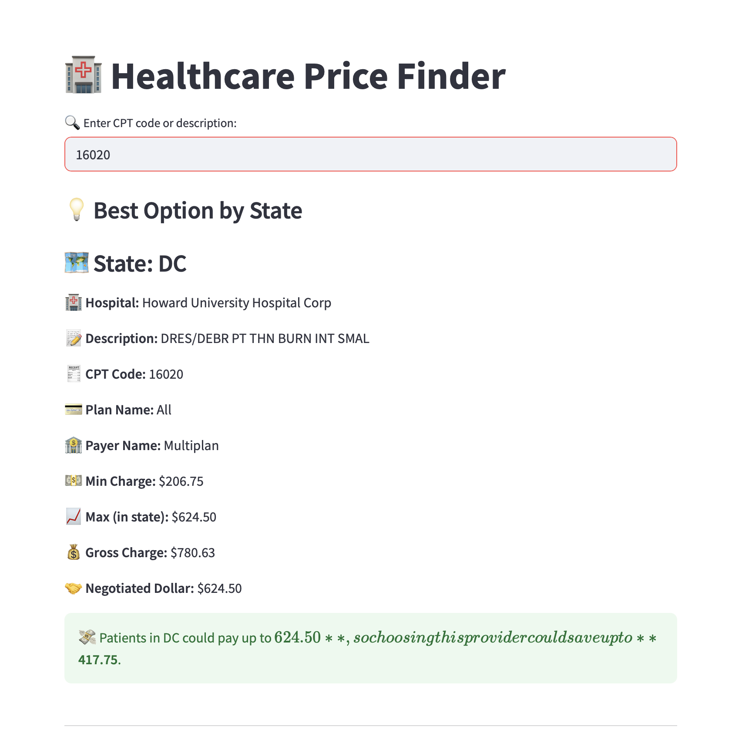
CHATBOT

Slide 9
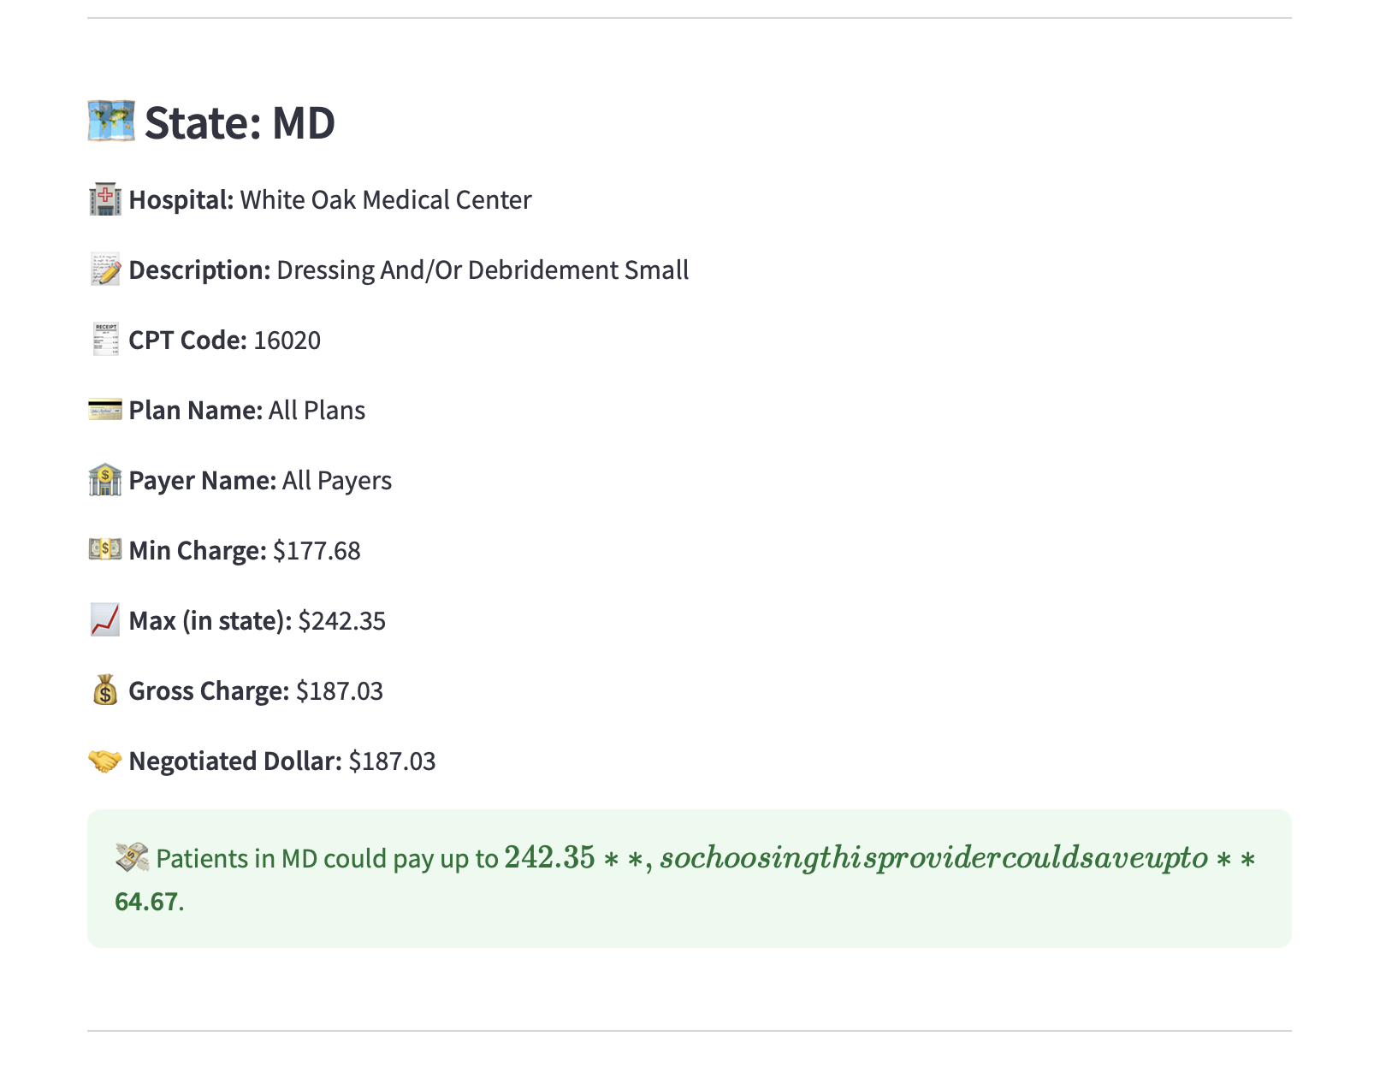
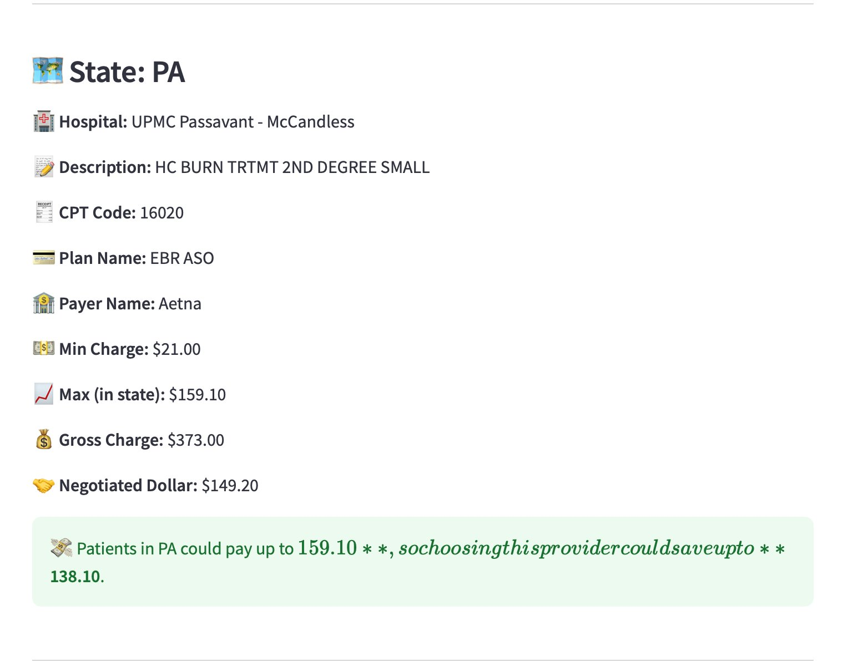

Slide 10
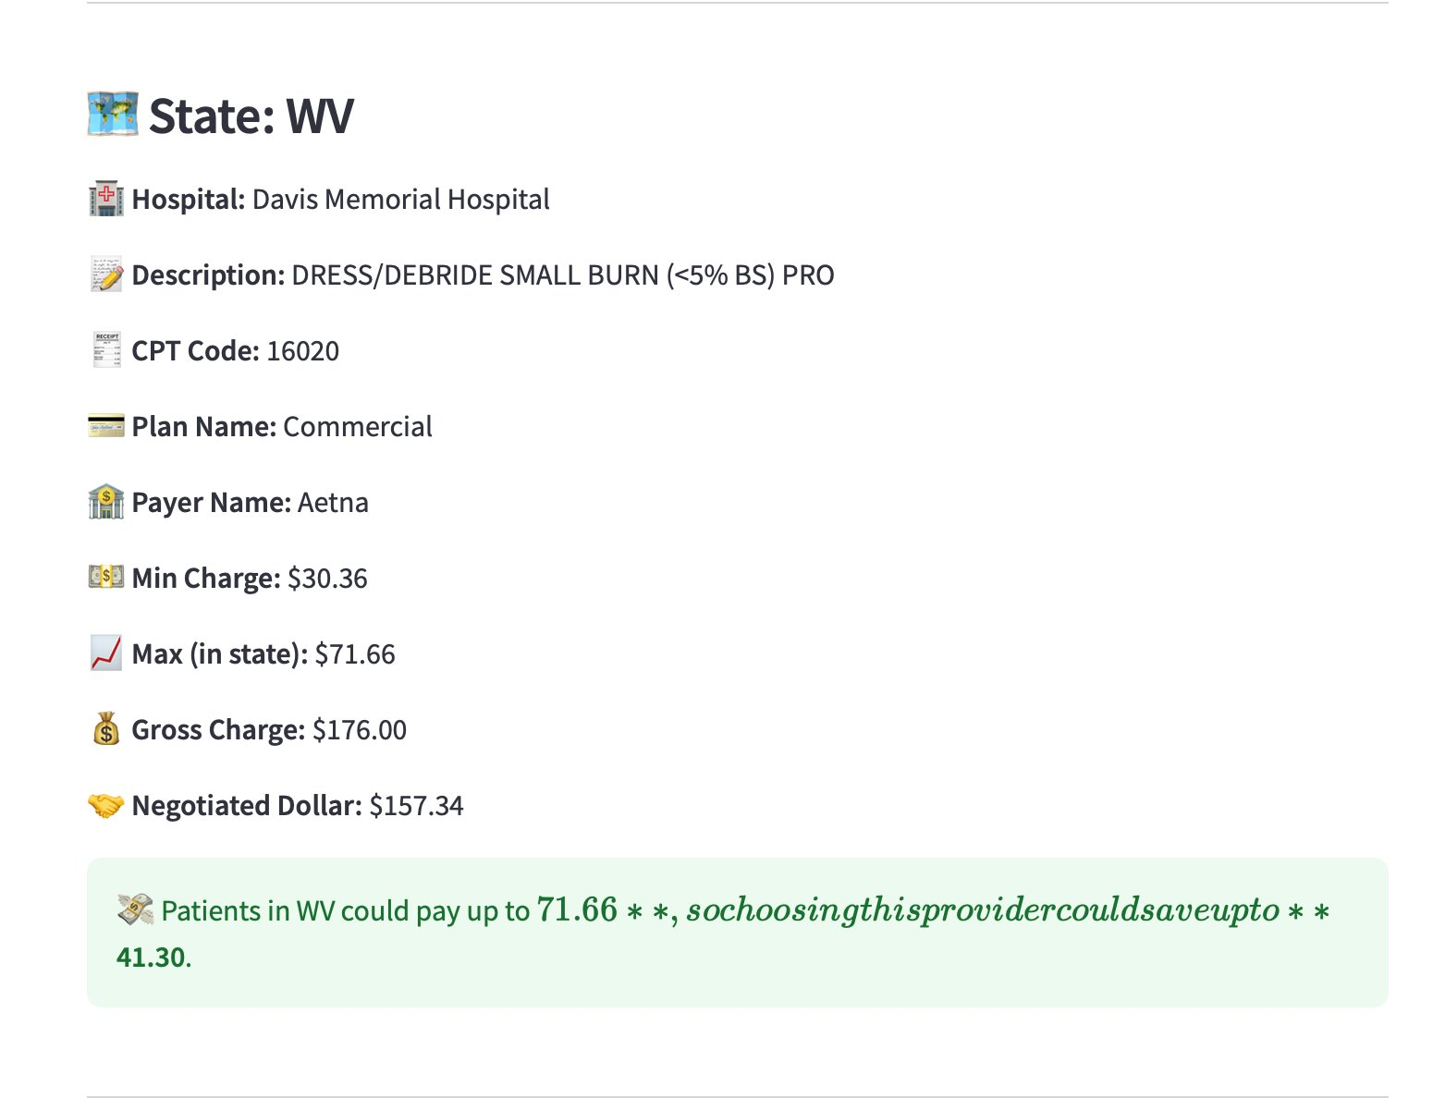
Technologies used in the Chatbot: 1. Streamlit for Frontend end. 2. Python and Pandas for backend. 3. Is scalable and easily be deployed on azure or can be run locally.

Slide 11
THANK YOU!!

